Slide 1

Enigmatic Maze Game
April 2025
Wesley Cassel
Bachelor’s in Applied Computing with a Cybersecurity Concentration
Mr. O’Neill

Slide 2

Purpose
Mazes have devolved into being too easy and viewed as unnecessary children's games
Wanted to improve upon the formula and make more interesting mazes
Wanted to utilize riddles to make mazes more challenging and provide a better brain boost than just simple mazes
Wanted to utilize new formula to perhaps help elderly folk who could use the benefits both riddles and mazes provide to the brain.

Slide 3
Research
Mazes benefits:
Sharpening memory (Why Solving Puzzles, 2021).
Improving hand-eye coordination (Why Solving Puzzles, 2021).
Helping with patience (Why Solving Puzzles, 2021).
Riddle benefits:
Require solver to utilize more of their knowledge of language, experience, and other mental activities to solve it (Marcel, 2009).
Improve critical thinking skills (Health Benefits).
Problem solving skills (Health Benefits).
Memory skills (Health Benefits).

Slide 4
Language, Software, & Hardware
Created using C++
Made in Windows 10
Created using Visual Studio Code
Requires 208 kb of storage
Played through terminal window

Slide 5
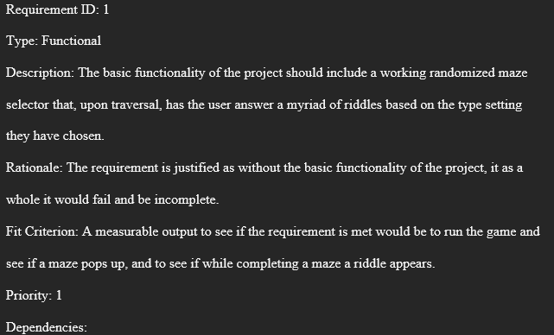
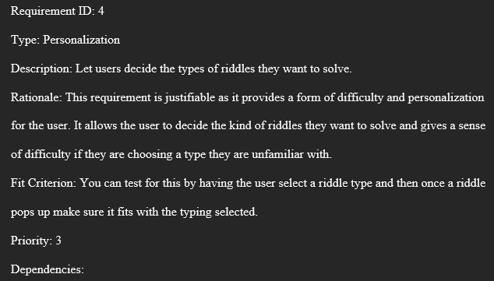
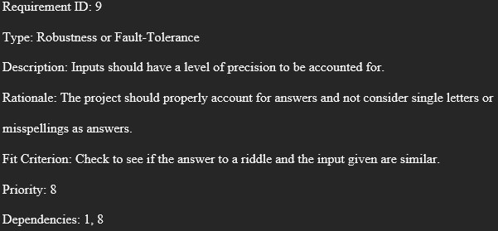
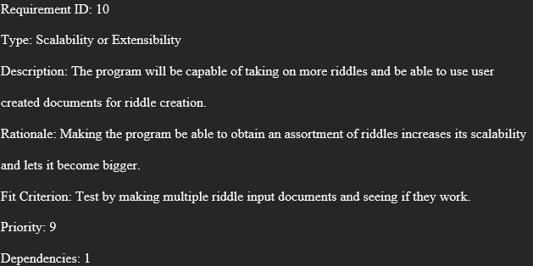
Example Requirements

Slide 6

Description
Multiple riddle types will be selectable such as scientific riddles, trivia riddles, & sports riddles.
A random maze will be selected from a selection of mazes.
The maze will be completely traversable and will have riddles pop up throughout the maze.
Attempts remaining will be shown.
A victory and game over screen will also occur when necessary

Slide 7
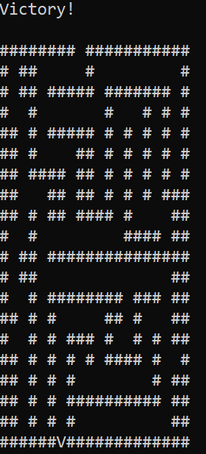
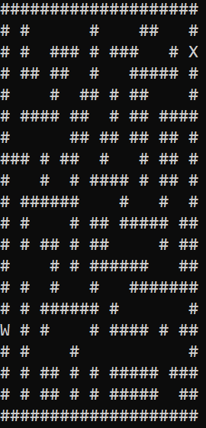
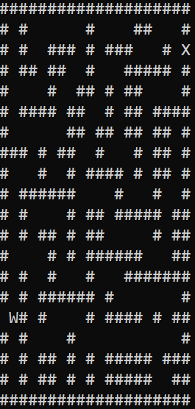
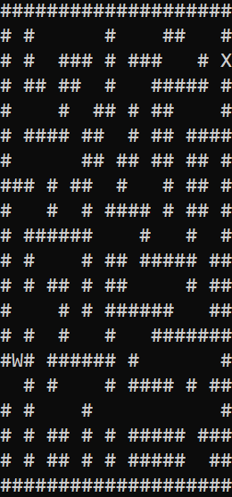

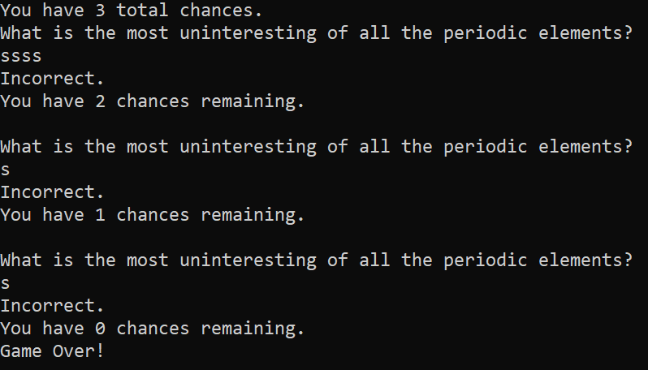
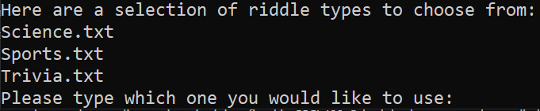
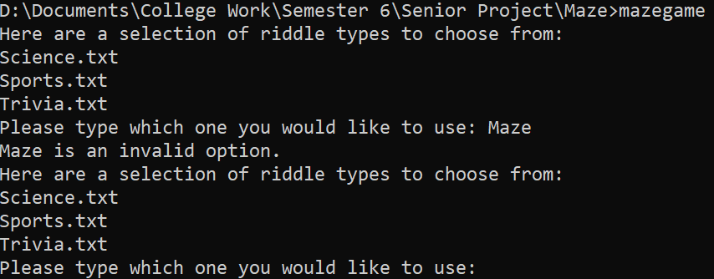

Slide 8

Packages
<iostream> for input and output
<string> for explaining instructions
<fstream> for reading the riddles from another document
<filesystem> for reading riddles from another document
<ctime> for helping set up randomness of riddles
<list> setting up the maze
<cstdlib> setting up randomization
<conio.h> allowing for instant user input
<chrono> setup wait time between correct answers
<thread> setup wait time between correct answers

Slide 9
Test Plan
A test plan will be utilized to ensure important features for the maze and riddles are implemented.
Goals:
Mazes are randomized
Riddle types appear throughout the maze
Riddles are randomized based on the proper type selected
Program optimized
User inputs work correctly
Features to be tested:
Functionality of the maze
Functionality of the riddles
Functionality of randomization tools
Functionality of user input
Functionality of riddle selection
Functionality of parsing files for selection
Functionality of Visuals
Fault-Tolerance of Answers
Scalability
Accessibility
Ensuring proper access
Automatic shutdown

Slide 10
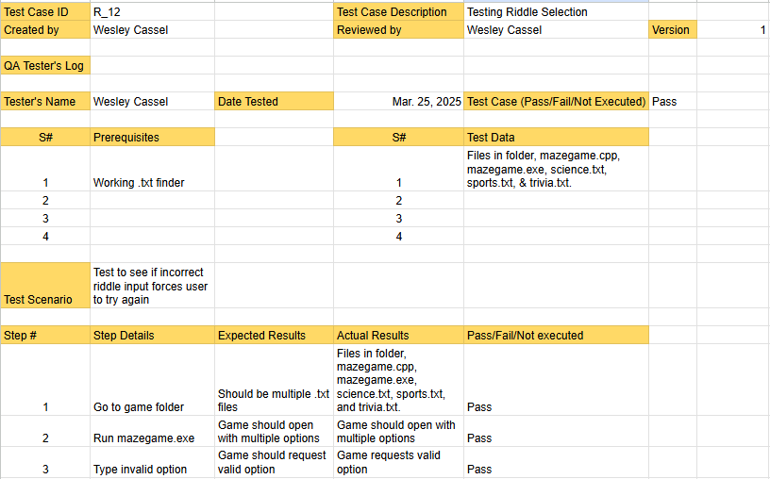
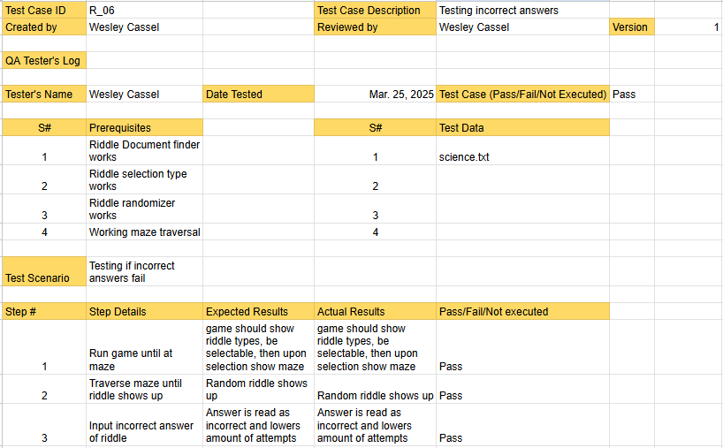
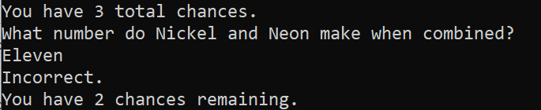
Examples of Testing

Slide 11
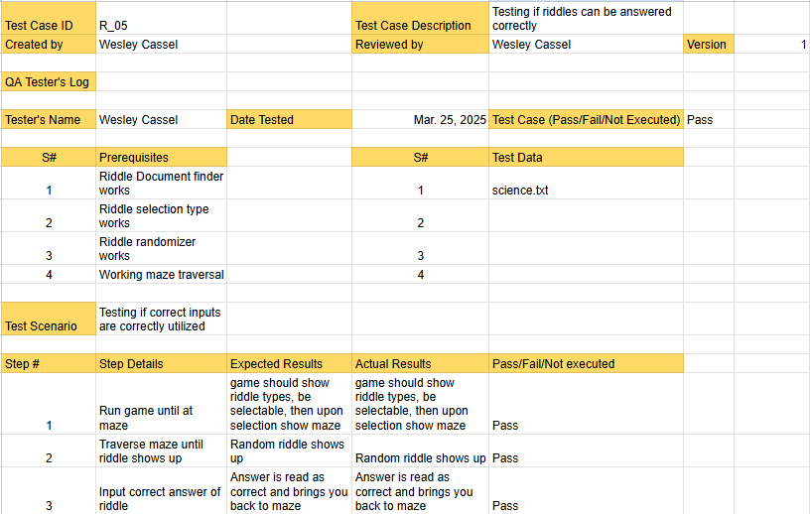
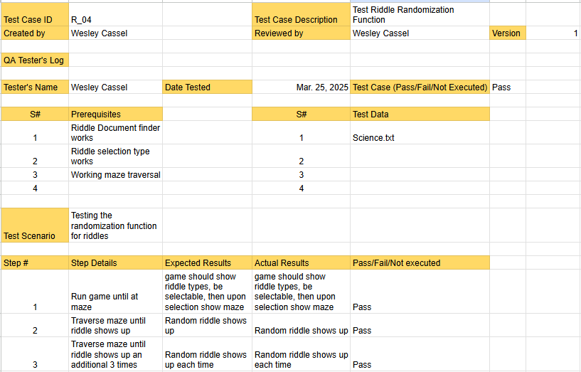
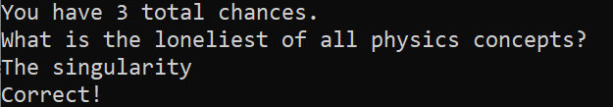

Examples of Testing

Slide 12

Challenges
Riddle type display showing non .txt files
Temp solution was used until permanent solution was found
Maze generation & traversal had poor optimization causing choppiness
Maze generation had difficulty being randomized.

Slide 13
The Future
More riddles
Different difficulty riddles
Better maze generation

Slide 14
Works Cited
Health Benefits of Solving Riddles – DoveMed. (n.d.) www.dovemed.com/healthy-living/wellness-center/health-benefits-solving-riddles
Marcel, D. (2009). Puzzles and the brain. Psychology Today. http://www.psychologytoday.com/us/blog/brain-workout/200904/puzzles-and-the-brain
Why solving puzzles and Mazes helps with a growth mindset. Kai’s Education. (2021). https://kaiseducation.com/why-solving-puzzles-and-mazes-helps-with-a-growth-mindset/

